Slide 1
Reading, Writing, and the Scientific Literature

Slide 2
Daily Agenda
Categorizing, finding, evaluating, and organizing sources (20 min)
Critically reading papers (20 min)
Writing scientifically (20 min)
Structuring a white paper (20 min)

Slide 3
I. Scientific Sources

Slide 4
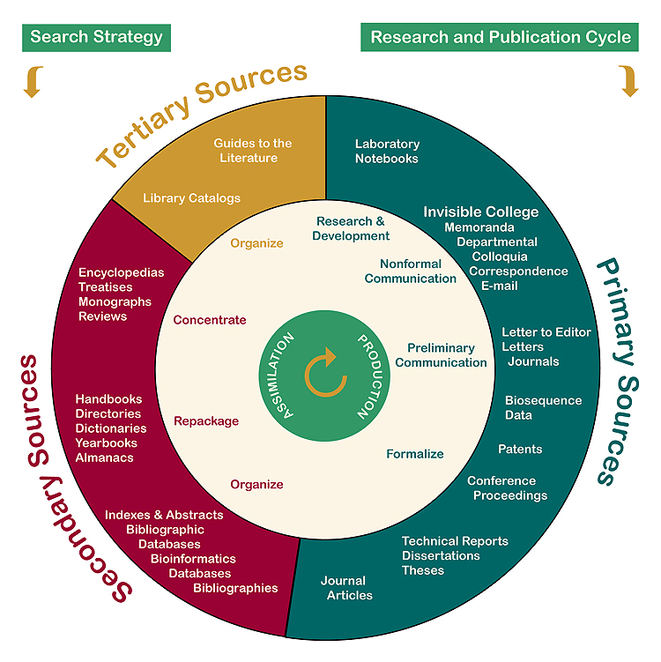
Types of sources
Notes:
Primary sources: documents of direct experience; formal or informal; formal examples usually peer reviewed.
Secondary sources: organize, distil, or review primary sources. Review articles are a type of secondary source that can be very useful for understanding and finding primary sources.
Tertiary sources: discovery tools for primary and secondary sources.

Slide 5
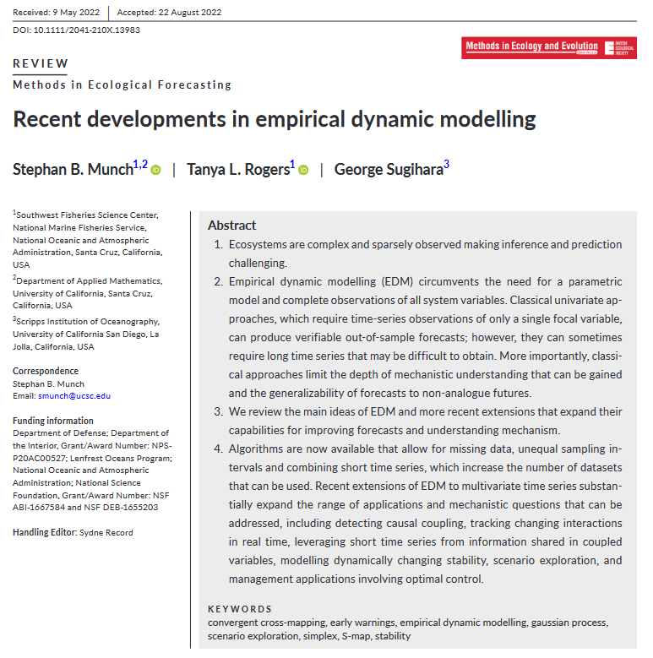
Is this a primary, secondary, or tertiary source?

Slide 6
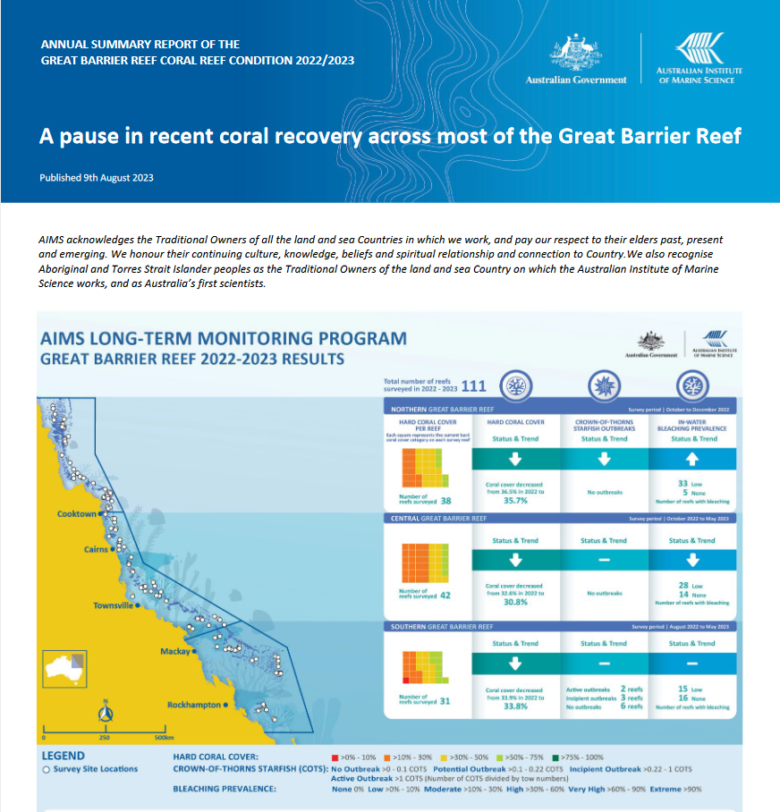
Is this a primary, secondary, or tertiary source?

Slide 7
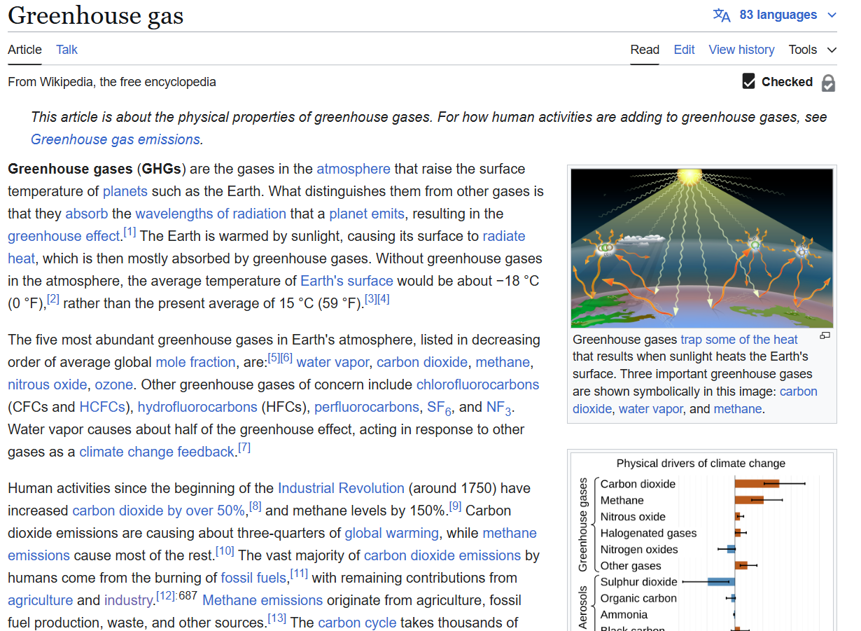
Is this a primary, secondary, or tertiary source?

Slide 8
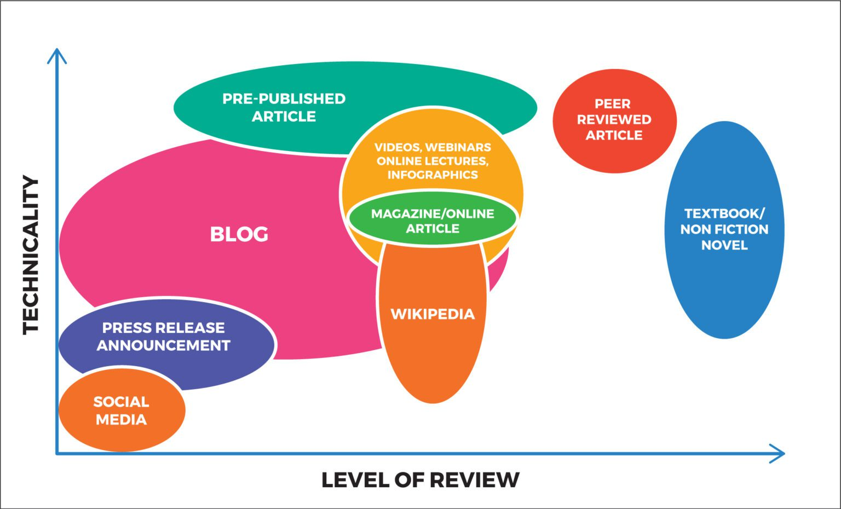
CLASS WHITE PAPERS

Slide 9
What is citable for this class?
 | Primary | Secondary | Tertiary
Peer-reviewed | YES | YES | NO
Non-reviewed | DEPENDS | NO | NO
Primary, non-reviewed example | Ok to cite?
Preprints | YES
Blog/Substack posts | NO
Dissertations/theses | YES
Social media posts | NO
Government documents | YES
Newspaper articles | YES

Slide 10
II. Reading Papers Critically

Slide 11
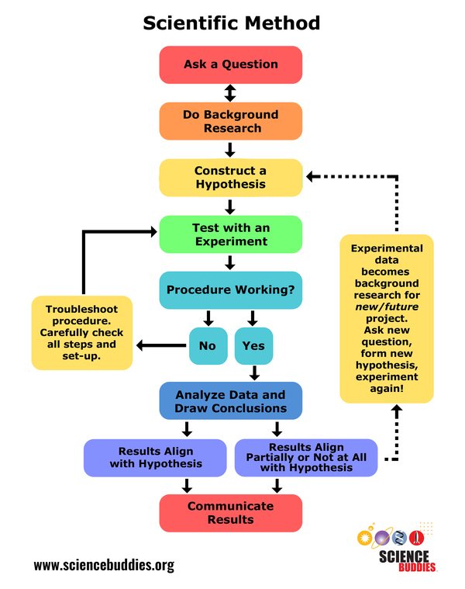
Typical paper sections
Abstract
Introduction
Materials and methods
Results
Discussion
Acknowledgements
References
What steps of the scientific method belong in each paper section?

Slide 12
III. Scientific Writing

Slide 13
Scientific writing process
What we think the writing process should be: linear.
Prewriting
Drafting
Revising
Editing
Publication
What the writing process actually is: iterative.
Revisions from coauthors and colleagues
Prewriting
Drafting
Revising
Editing
Publication
Revisions from peer reviewers and editors
Notes:
Prewriting – generate ideas, identify evidence and sources, and craft outlines
Drafting – transform the outline into logically connected sentences and paragraphs, add evidence
Revising – reorganize the draft, add evidence, eliminate tangents, correct misspellings and grammar, check citations and figures
Editing – submit for peer review
Publication – revise for copyediting after acceptance

Slide 14


Sentence styles
Past tense, active voice, personal
“We conducted an experiment to measure the effects of ultraviolet radiation on the productivity of marine phytoplankton.”
Present tense, active voice, personal
“We conduct an experiment to measure the effects of ultraviolet radiation on the productivity of marine phytoplankton.”
Past tense, passive voice, personal
“An experiment was conducted by us to measure the effects of ultraviolet radiation on the productivity of marine phytoplankton.”
Past tense, passive voice, impersonal
“An experiment was conducted to measure the effects of ultraviolet radiation on the productivity of marine phytoplankton.”

Slide 15
IV. White Papers

